Slide 1
November 2024
Evaluation of the pre and post of 3 days of training of EPPs on the malaria data management and care
Analysis of the scores obtained
Serge ZOLA

Slide 2
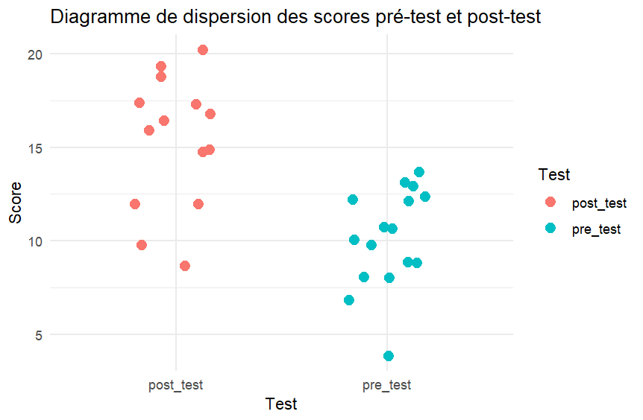
with scatter plot

Slide 3
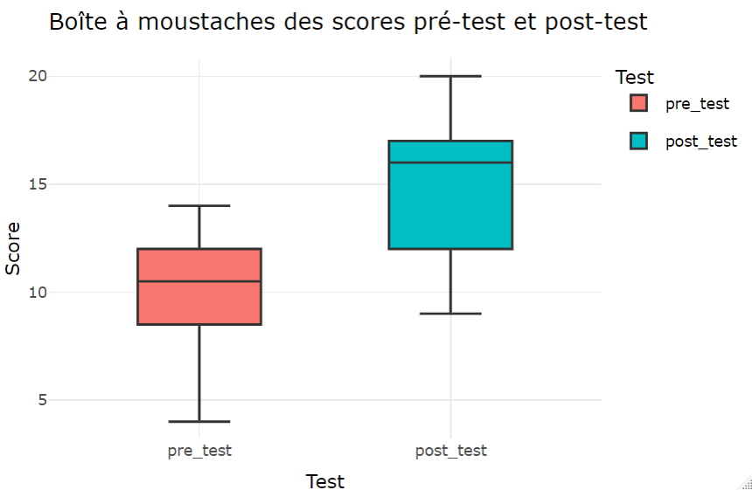
Results with box plot
Details
Post-test:
Min: 9
Max: 20
Median: 16
Mode: 17
Post-test:
Min: 4
Max: 14
Median: 10.5
Mode: 12

Slide 4
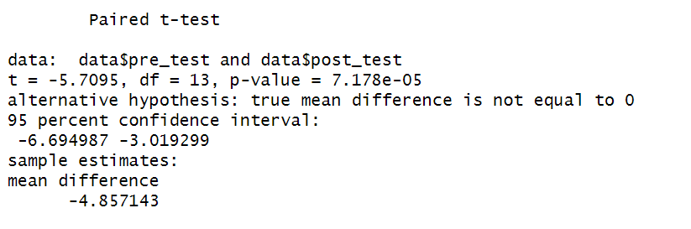
Paired-samples t-test results
The results show a significant difference between the pre-test and post-test scores. The training appears to have had an impact
t-statistic (t = -5.7095) : The t-value indicates the size of the difference relative to the variation in your data samples.
p-value (p = 7.178e-05) : the observed difference is statistically significant because this result indicates that we can reject the null hypothesis.
95% Confidence Interval (-6.694987, -3.019299 ) : What comforts us with this result is that the confidence interval is 95% and the true mean difference between the pre-test and post-test scores is between -6.695 and -3.019. This interval does not contain zero.
Average difference ( mean difference = -4.857143) : The mean difference indicates that, on average, the post-test scores are about 4.86 points lower than the pre-test scores. However, this seems counterintuitive, as one would expect the post-test scores to be higher after training. This is because two candidates did not complete the post-tests

